Slide 1
Object Oriented Programming Data Members (Pointers)
CS(217) Object Oriented Programming
Abeeda Akram

Slide 2
Data Members(Simple)
class Point {
int x;
int y;
float calculateDistance(Point &p) const;
public:
//getters
int getX();
int getY();
Point getPoint();
//setters
void setX(int x);
void setY(int y);
void setPoint(int x, int y);
void setPoint(Point p);
//Other functions //Accessors
void printPoint() const;
Point find_closest (Point &p1, Point &p2) const;
};

Slide 3
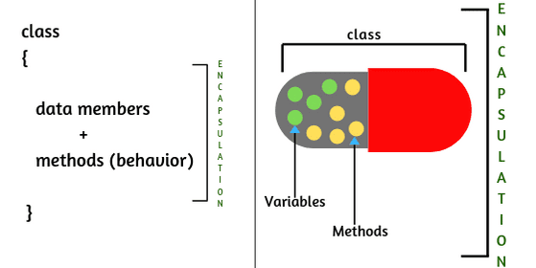
Class Data Members (TYPES)
Simple
Pointers Dynamic Memory
Used for dynamic memory management of objects
Initialization and allocation of memory through constructors
Default
Parameterized
Copy
Deallocation of memory through destructor
If not implemented object’s memory may get leaked.

Slide 4
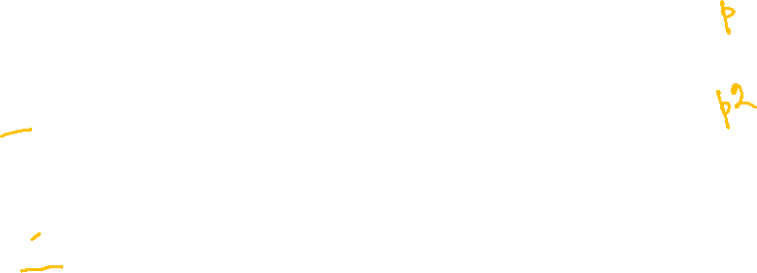
Member functions (Default Constructor)
X
y
class Point {
int x;
int * y;
public:
//Default constructor
Point();
};
Point::Point(){
x = 0;
y = nullptr;
//Initialized to nullptr
}
void main(){
Point p;
Point p2;
}
0
0
X
y
0
0

Slide 5
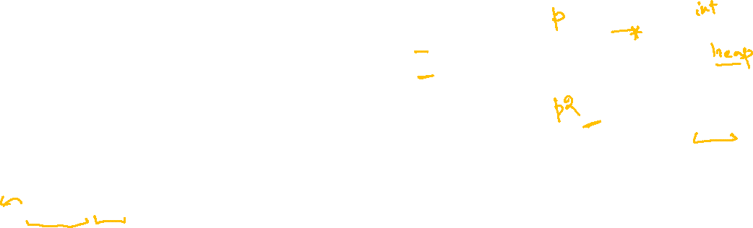
Member functions (Default Constructor)
X
y
class Point {
int x;
int * y;
public:
//Default constructor
Point();
};
Point::Point(){
x = 0;
y = new int (0);
//Allocates memory
}
void main(){
Point p;
Point p2;
}
0
0
X
y
0
0

Slide 6
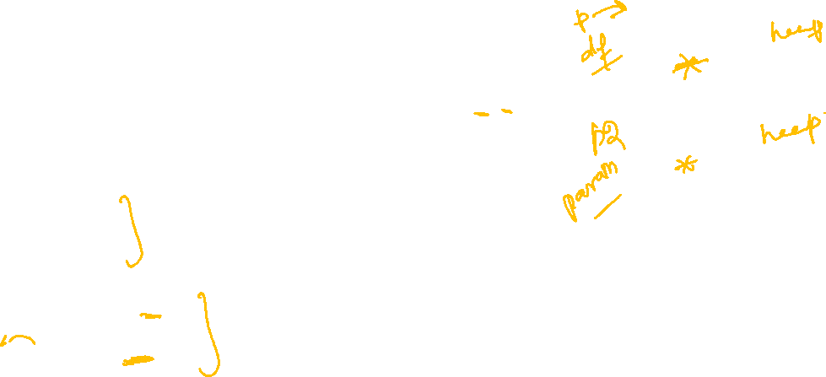
Member functions (Parameterized Constructors)
X
y
class Point {
int x;
int * y;
public:
Point();
Point(int x, int y);
};
Point::Point(){
x = 0;
y = new int (0);
}
Point::Point(int x, int y){
this->x = x;
this->y = new int (y);
//Allocates memory
}
void main(){
Point p;
Point p2 (5,8);
}
0
0
X
y
5
8

Slide 7
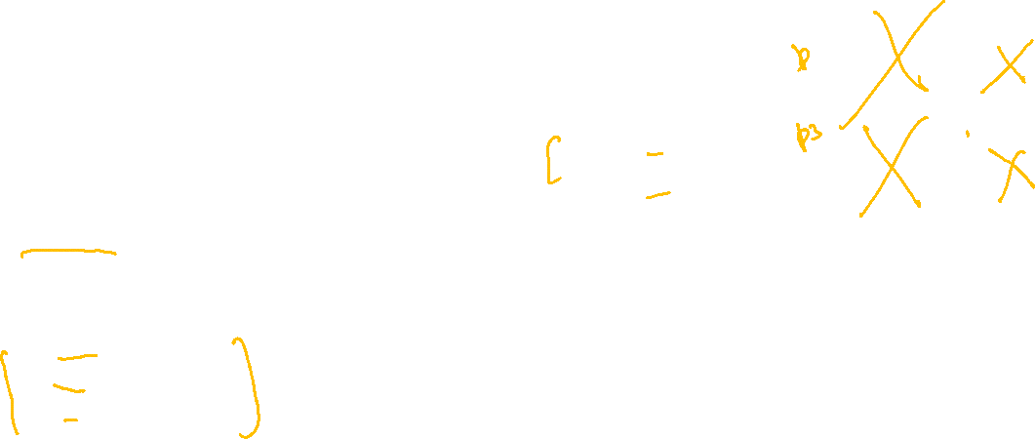
Member functions (Destructor)
Can add only one destructor in a class
X
y
0
class Point {
int x;
int * y;
public:
Point();
Point(int x, int y)
~Point();
};
//Destructor Deallocates memory
Point::~Point(){
if(y!=nullptr) {
delete y;
y= nullptr;
}
}
void main(){
{
Point p;
Point p3(5,8);
}
//Destructor called
//Destructor called
//Destructor called
cout << "out of block";
}
0
X
y
5
8

Slide 8
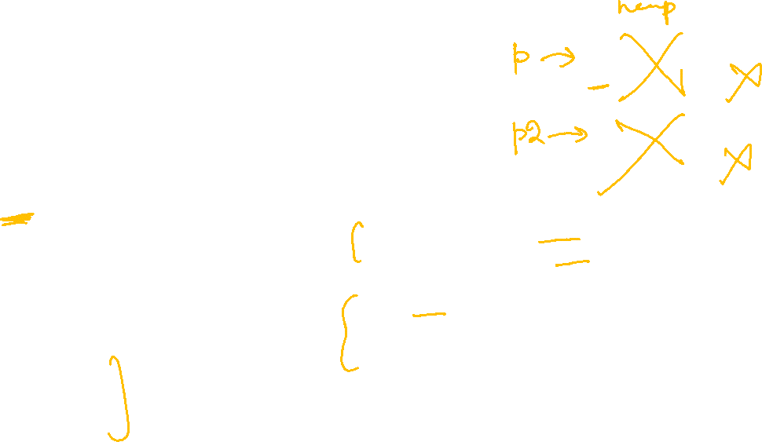
Member functions (Destructor)
X
y
0
0
Can add only one destructor in a class
X
y
5
class Point {
int x;
int * y;
public:
Point();
Point(int x, int y)
~Point();
};
//Deallocates memory
Point::~Point(){
if(y!=nullptr) {
delete y;
y= nullptr;
}
}
void main(){
//Dynamic Objects
Point * p = new Point;
Point * p2 = new Point(5,8);
delete p;
//Destructor called
delete p2;
//Destructor called
}
8

Slide 9
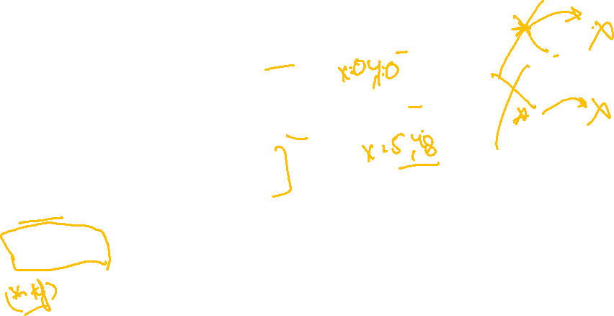
Member functions (Other Functions)
Change implementation of all member functions according to pointer type
class Point {
int x;
int * y;
public:
Point();
Point(int x, int y)
~Point();
void printPoint() const;
};
void Point::printPoint() const {
cout<< " X: " << this->x;
if(y!=nullptr) {
cout<< " Y: " << *(this->y);
}
void main(){
Point * p = new Point;
p->printPoint();
Point * p2 = new Point(5,8);
p2->printPoint();
delete p;
delete p2;
}
X
y
0
0
X
y
5
8

Slide 10
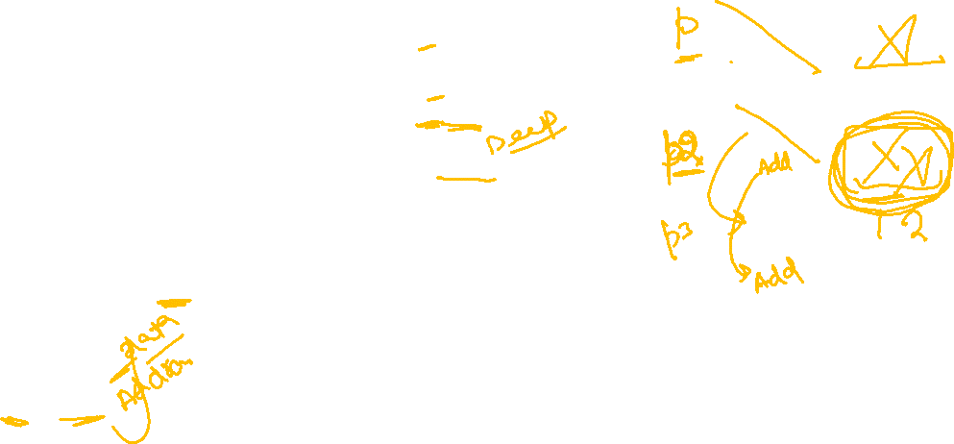
Member functions (Copy Constructor)
void main(){
Point p;
Point p2(5,8);
Point p3(p2);
//Do Shallow copy of
Pointer members
//Run time Error when
destructor called memory deallocated twice
}
X
y
class Point {
int x;
int * y;
public:
Point();
Point(int x, int y)
~Point();
Point(const Point & p);
};
//Copy Constructor
Point::Point(const Point & p)
{
this->x = p.x;
this->y = p.y;
}
0
0
X
y
5
8
X
y
5

Slide 11
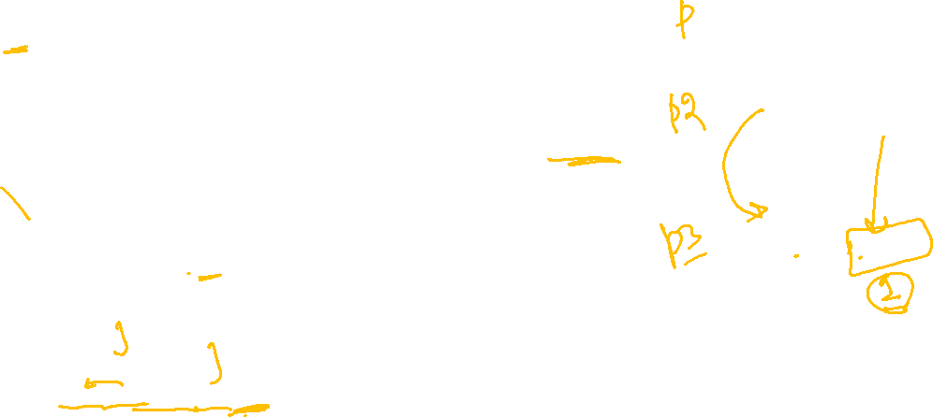
Member functions (Copy Constructor)
void main(){
Point p;
Point p2(5,8);
Point p3(p2);
//Must do deep copy of
Pointer members
}
X
y
class Point {
int x;
int * y;
public:
Point();
Point(int x, int y)
~Point();
Point(const Point & p);
};
//Copy Constructor
Point::Point(const Point & p)
{
this->x = p.x;
y = nullptr;
if(p.y != nullptr) {
this->y = new int (p.y);
}
0
0
X
y
5
8
X
y
5
8

Slide 12

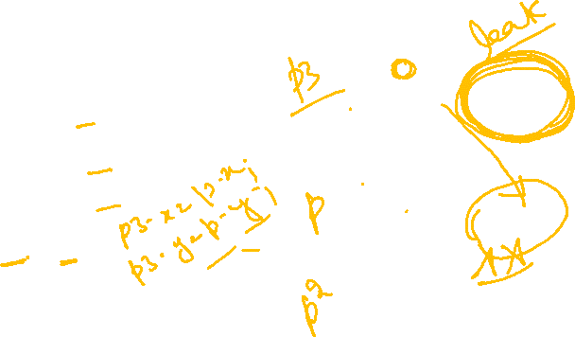
Member functions (Assignment)
X
y
void main(){
Point p;
Point p2(5,8);
Point p3(p2);
p3 = p;
//Aggregate member wise
assignment of data
}
5
class Point {
int x;
int * y;
public:
Point();
Point(int x, int y)
~Point();
Point(const Point & p);
};
//Do Shallow copy of Pointer members
//Memory leaked
//Run time Error when destructor called memory deallocated twice
8
X
y
0
0
X
y
5
8
How to fix
By adding our own
assignment function

Slide 13

Data Members(Pointers)
When Pointer members are part of class
must add following functions in class
Constructors ( default or parameterized for allocation of memory )
Copy Constructor ( for deep copy of dynamic memory )
Destructor ( for deallocation of dynamic memory )
Assignment Function (for deep copy of dynamic memory )

